Slide 1
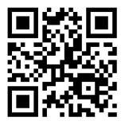

Welcome to the
Manchester Community College, Manchester NH
November 3, 2018
SCHEDULE: http://bit.ly/NHCC2018

Slide 2


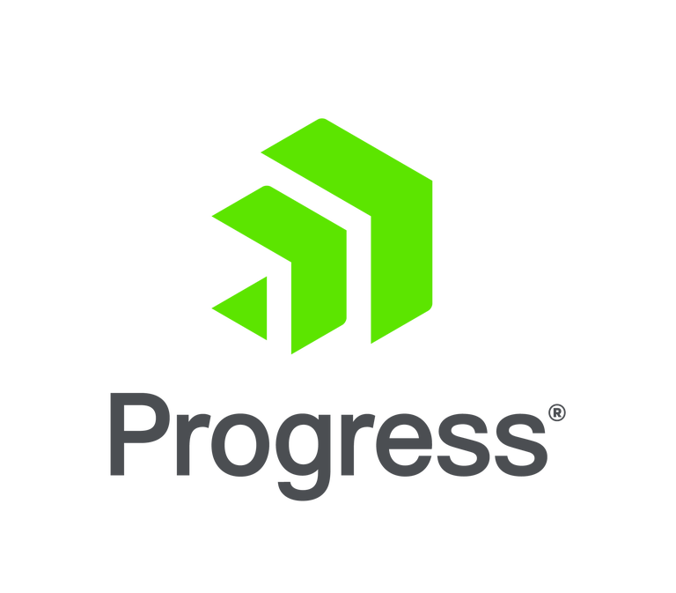




A BIG thank you to our 2018 Sponsors!

Slide 3






Another BIG thank you to our sponsors!

Slide 4
Wi-Fi
Please connect to the Wi-Fi network
Wi-Fi SID: MCC (space) Wi-Fi
No username or password.
This is an open Wi-Fi – the internet provider pops up a message that states it is insecure. Just hit enter again.

Slide 5
Day's Schedule http://bit.ly/NHCC2018
Time | Activity
8:000am – 9:00am | Guest arrival, Registration
8:30am – 9:00am | Welcome
9:00am – 12:30pm | Sessions
12:30pm – 1:30pm | Lunch
1:30pm – 3:30pm | Sessions
afternoon | Coffee/Snacks Available
3:30pm – 4:00pm | Closing Remarks, Questions, Raffle & Guest Departure

Slide 6

Location
Address Manchester Community College 1066 Front Street Manchester, NH 03102
Phone: (603) 206-8000
Medical Emergency: Dial 911 and give address

Slide 7

Developing Cross-Platform AR Experiences using Unity and C#
Roman Jaquez
Software Engineer / AR Enthusiast

Slide 8
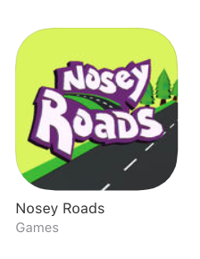
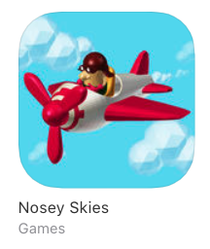
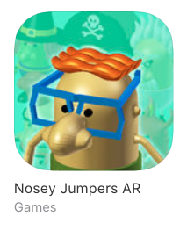
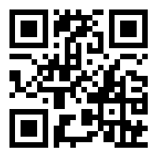

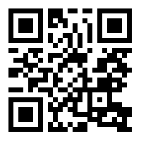
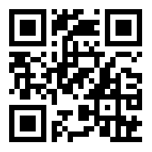
AR Apps on the App Store

Slide 9

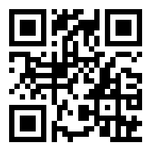
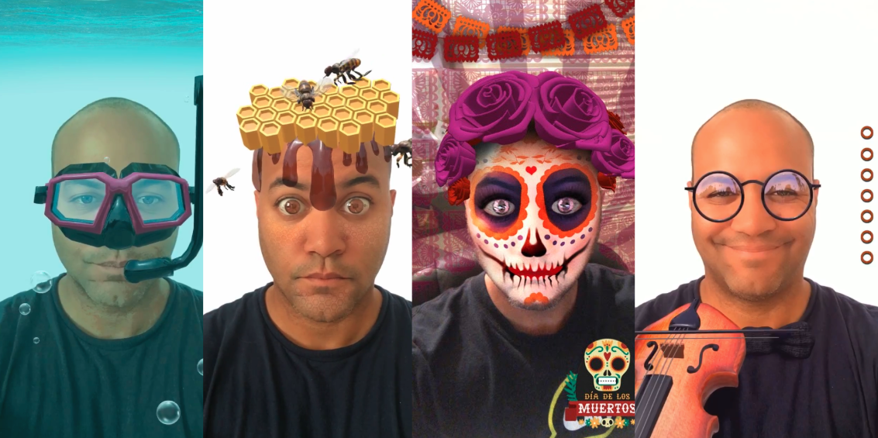
Official Snapchat Lens Creator

Slide 10
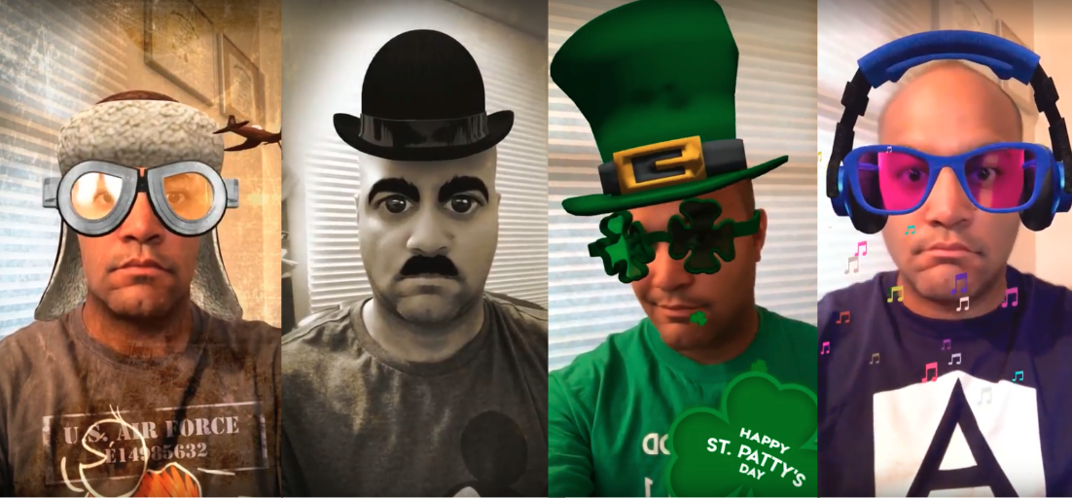

Official Snapchat Lens Creator

Slide 11


What's Unity 3D?
Cross-Platform Game Engine for developing 2D and 3D games and graphic-intensive applications
Intuitive Graphic Interface (drag / drop functionality)
Primary programming language is C#
De-facto IDE for AR / VR development

Slide 12










What's Unity 3D?
Current version is 2018.2.14
FREE for Personal use (revenue < $100K)
Vast collection of free assets at your disposal @ the Unity Store, as well as plugins
One single codebase to deploy into the following platforms:

Slide 13
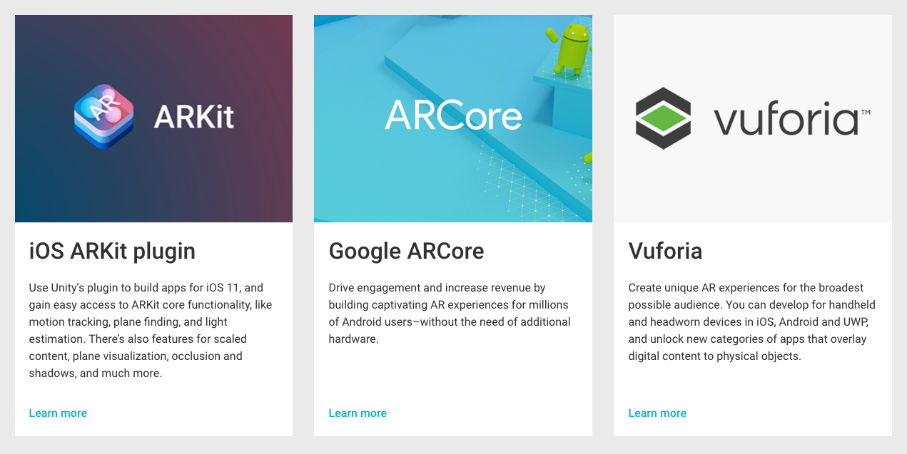
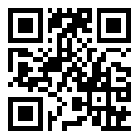
Augmented Reality under Unity
Simplifies the complexity of ARCore and ARKit under a single plugin, without having to create separate apps or maintaining multiple codebases
https://goo.gl/ccSyhe

Slide 14

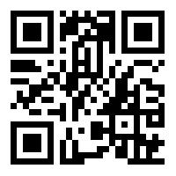
AR Foundation
Use the AR Foundation package to add high-level functionality for working with augmented reality
Unity 2018.1+ includes built-in multi-platform support for AR
Hides the complexity of AR into a single API supported by Unity
Focus on your users' experience, leave the rest to ARFoundation
https://goo.gl/psWNrP

Slide 15
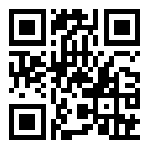
AR Foundation (cont.)
AR Foundation is a set of classes (inheriting from MonoBehaviour) for dealing with devices that support following concepts:
Planar surface detection
Point clouds, also known as feature points
Reference points: an arbitrary position and orientation that the device tracks
Light estimation: estimates for average color temperature and brightness in physical space.
World tracking: tracking the device's position and orientation in physical space.
https://goo.gl/x1jvPi

Slide 16

AR Foundation (cont.)
Prerequisites
If you want to deploy to your IOS device
A Mac
Latest version of XCode (10.0, targetting IOS 11+)
Deploy to Android Device
Android Studio + SDK
A list of devices that have ARCore support
Unity Packages
ARCore XR Plugin for Unity
ARKit XR Plugin for Unity
AR Foundation

Slide 17

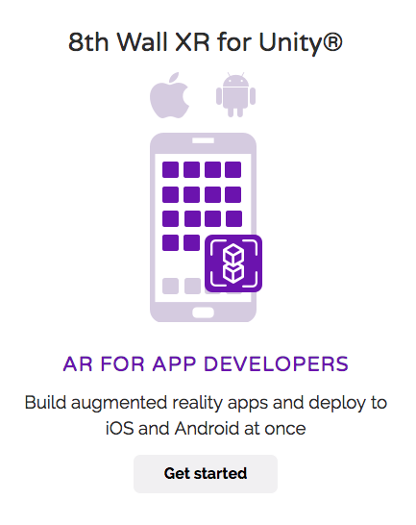
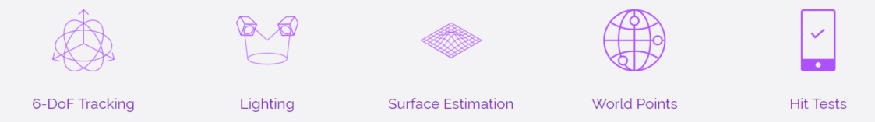
8th Wall
Augmented Reality for the Web
Built using Javascript and WebGL
Hyper-optimized for real-time AR on mobile browsers

Slide 18
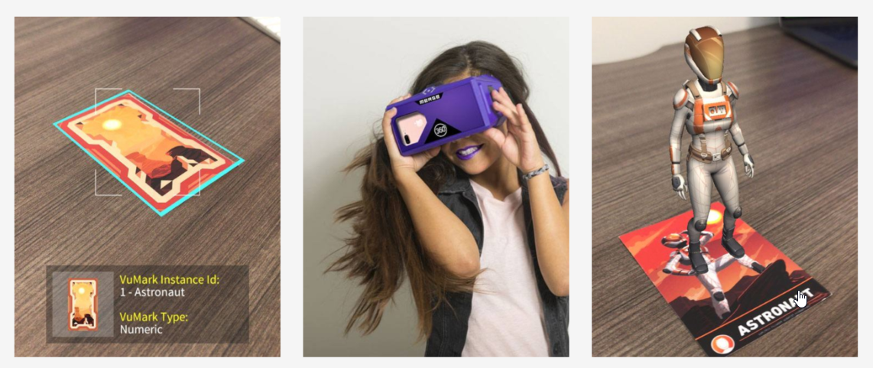
Vuforia: Marker-based AR
It’s easy to start creating AR content using Vuforia Engine.
Install Vuforia Engine with the Unity Editor.
Create a new project and activate Vuforia Engine.
Import the Vuforia Engine Core Samples.
Customize them with your own content.
It's that simple.

Slide 19

Resources
Unity 3d
https://unity3d.com/
ARFoundation GitHub Samples
https://github.com/Unity-Technologies/arfoundation-samples
ARFoundation Documentation (basic)
https://docs.unity3d.com/Packages/com.unity.xr.arfoundation@1.0/manual/index.html
8th Wall
https://8thwall.com/
Vuforia (marker-based AR)

Slide 20
Thank you

